Slide 1
Ethical issues
OF
DRONE
USE

Slide 2
NEED FOR ETHICS IN DRONE TECHNOLOGIES
Tripti Vishwakarma
Colorado State University Global
Course Code: CSC 502 – 2
Dr Steven A. Evans
Oct 9, 2024

Slide 3
PROBLEMS
ASSOCIATED WITH
WIDESPREAD ADOPTION OF
DRONE TECHNOLOGIES

Slide 4


Privacy
Drones can capture images and videos from people and places, often without their knowledge or consent, leading to privacy violations.
Drones give governments and businesses the ability to monitor large populations or specific areas continuously, creating concerns about unchecked surveillance.
drones can be used to track political opponents or citizens, making it easier for governments to control or monitor the public.

Slide 5
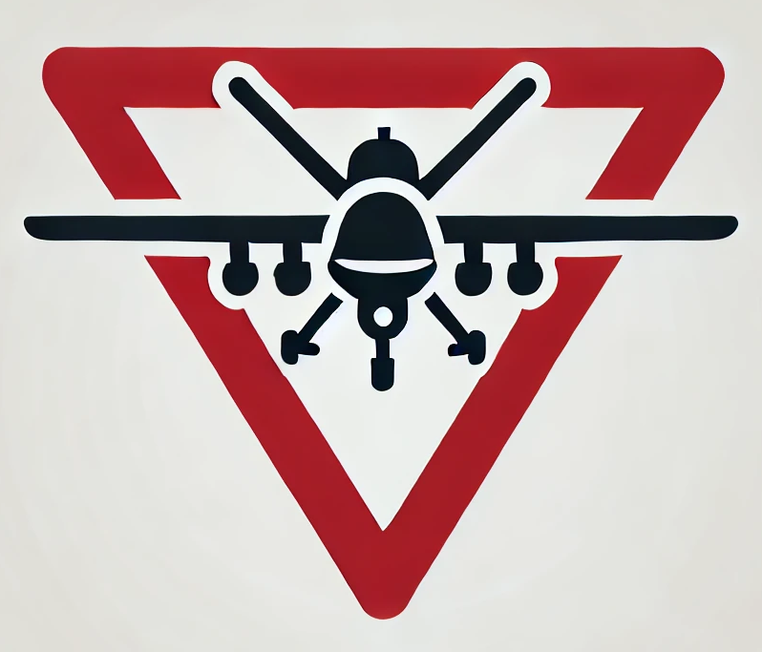
Drone Weapons
Drones used for military strikes can sometimes miss their targets, causing unintended civilian casualties and raising serious ethical questions about their use in conflict zones.
The ease of using drones for surveillance or attacks can make it tempting to use them more often, which could worsen tensions or escalate violence
When drones are used in military operations, it’s not always clear who is responsible when things go wrong, especially in areas where multiple groups are involved.
drones can fall into the hands of actors, who could use them for attacks, making conflict even more dangerous.

Slide 6

Safety & Congestion
Drones can crash or malfunction, causing mid-air collisions or accidents, especially in crowded areas or near airports, which poses a big safety risk
drones used for things like agriculture or disaster relief could accidentally fly into populated areas, potentially injuring people on the ground.

Slide 7

Widening Income Inequality
drones often benefit urban areas and wealthier groups, leaving rural or remote communities without access due to high costs and lack of infrastructure.
Drones could improve agriculture, healthcare, and disaster relief, but smaller farmers or underserved communities may not see these benefits, as they can't afford the technology or don't have the technical know-how.

Slide 8

Authorities studying drone use ethics
African Union Commission. (2020). Drone technology in Africa: Opportunities and challenges. Addis Ababa: African Union. https://au.int/
Centre for Internet & Society. (2019). The ethical implications of drones in India’s surveillance operations. Bengaluru: Centre for Internet & Society. https://cis-india.org/
Council for Scientific and Industrial Research. (2021). Drones in Africa: Balancing innovation and ethics. Pretoria: CSIR. https://www.csir.co.za/
Kenya Civil Aviation Authority. (2022). Ethical and regulatory considerations for unmanned aerial vehicles in Kenya. Nairobi: KCAA. https://www.kcaa.or.ke/

Slide 9
CONCLUSION AND CALL TO ACTION
Conclusion: Drone technologies offer benefits but pose significant ethical challenges. (Finn & Wright, 2012; Clarke, 2014; Cahill & Banks, 2014; Strawser, 2010)
Call to Action: Policymakers, technologists, and society must collaborate to develop ethical guidelines and robust regulatory frameworks.

Slide 10

References
Cahill, B., & Banks, J. (2014). The challenges and opportunities of integrating unmanned aircraft into the national airspace system. IEEE Technology and Society Magazine, 33(3), 28-34.
Clarke, R. (2014). Understanding the drone epidemic. Computer Law & Security Review, 30(3), 230-246.
Finn, R. L., & Wright, D. (2012). Unmanned aircraft systems: Surveillance, ethics, and privacy in civil applications. Computer Law & Security Review, 28(2), 184-194.
Strawser, B. J. (2010). Moral predators: The duty to employ uninhabited aerial vehicles. Journal of Military Ethics, 9(4), 342-368.

Slide 11
END

